Slide 1
Little house in the big woods
By Laura Ingalls Wilder

Slide 2
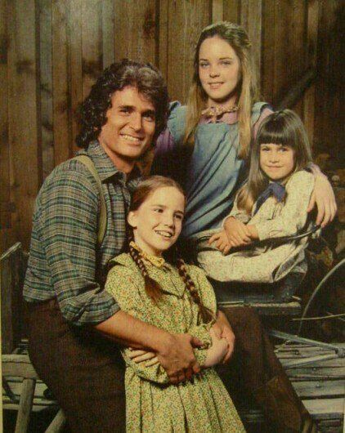
Why read this book?
If you enjoy adventure stories, you will like this book.
Mary, Laura and their baby sister Carrie live in the deep woods of Wisconsin.
They have to adjust to life in the woods, as they get ready to preserve food for winter.

Slide 3
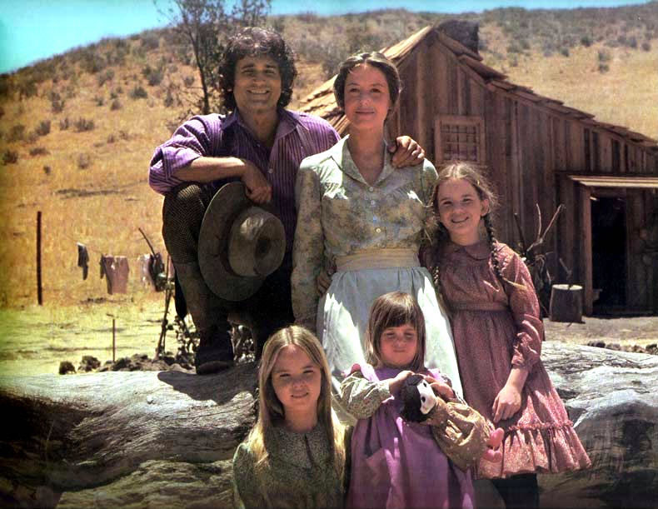
Winter nights…
The children’s father is out every day killing prey for food , so they now have to keep busy doing chores.
As a family, they are preparing meats and vegetables for winter as they can’t hunt for prey in the snow.

Slide 4
Quotes
‘There’s no great loss without some small gain’- Little house on the prairie
‘There is nothing in the world so good as good neighbours’ – On the banks of plum creek

