Slide 1
Using representations to support problem solving
Pete Griffin

Slide 2
Solving Problems
Tom has 20 sweets and shares some of them with his sister.
He gives his sister 5.
How many does he have?
Notes:
The strategy of highlighting key words to discern what needs to be done to solve a word problem can become mechanistic.
Such a strategy based as it is on analysing language does not always offer insight into the structure of the problem.

Slide 3
Knowing to …
I can know-that something is true as a fact. I can know-how to do something. I can know-why those techniques work or why those facts are true.
But these “knowings” when taught are hard to move beyond book-knowledge, knowledge-about. The knowing-that can be memorised; the knowing-how can be routine, and the knowing-why a collection of “incantations” and learned phrases.
What really matters in our increasingly problem-oriented culture is knowing-to use this or that technique, this or that way of thinking, this or that approach, in a given situation as and when it arises.
(From “Questions and Prompts for Mathematical Thinking”, Watson and Mason, ATM, 1998).
Notes:
When solving word problems it is often it is not the calculation that children can’t do – rather they are not sure what calculation they need to do.

Slide 4
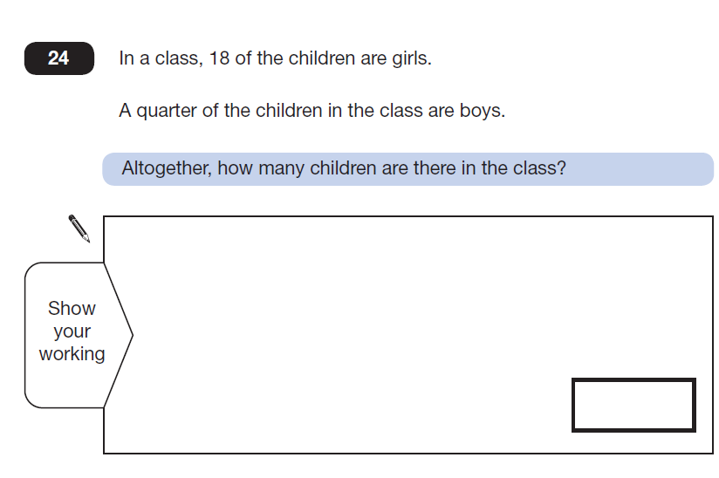
Notes:
Now ask participants to solve this problem and discuss how the representation of the bar(s) might provide greater opportunity for success

Slide 5
Laura had $240. She spent 5/8 of it.
How much money did she have left?
Overall percent correct:
Singapore: 78%,
United States: 25%
Why were Singapore so successful?
They used a particular representation which
enabled pupils to access the structure of the
mathematics
Notes:
This is taken from a research article, which can be accessed on the web
http://math.coe.uga.edu/tme/issues/v14n1/v14n1.Beckmann.pdf
Reference: Beckman, Sybilla. (2004). Solving algebra and other story problems with simple diagrams: A method demonstrated in grade 4–6 texts used in Singapore. The Mathematics Educator, 14(1), 42–46.
Ask participants to solve the problem any way they wanted. You might wish to illustrate how it could be solved using the bar, or you might save this till later

Slide 6
Introducing the bar model
The bar model is introduced within the context of part/whole relationships to solving problems involving the concepts of addition and subtraction.
It exposes the relationships within the structure of the mathematics, which are used to find the unknown elements and thus supports the development of algebraic thinking.
Notes:
Relationships within the

Slide 7
Addition and Subtraction

Slide 8
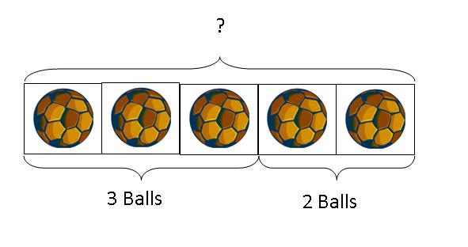
Addition: Aggregation
There are 3 footballs in the red basket and 2 footballs in the blue basket.
How many footballs are there altogether?
Notes:
This illustrates part whole relationships
Concrete to abstract
In Singapore there would be a progression from concrete objects, in this case footballs, to pictures of objects to spaces on the bar(s) to represents objects
Refer back to the structures of addition explored in residential 1
In this model aggregation can be seen in the two sets of balls coming together and being combined in the one strip
There is also the potential to sow the seeds and link to proportional reason in seeing 3 balls as a proportion of the whole
The importance of making connections in mathematics!

Slide 9
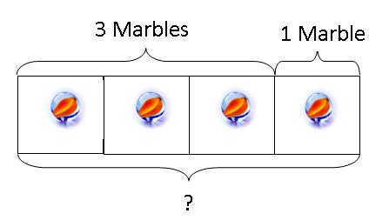
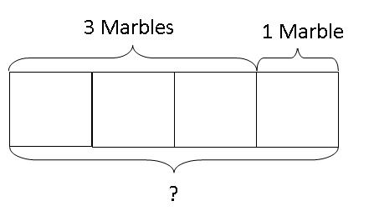
Addition: Augmentation
Peter has 3 marbles. Harry gives Peter 1 more marble. How many marbles does Peter have now?
Concrete Abstract
Notes:
Augmentation can also be seen in the representation
From concrete to pictorial to abstract where the objects are represented by spaces

Slide 10
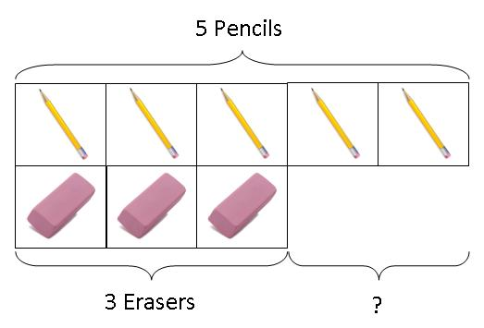
Subtraction: Comparison
Peter has 5 pencils and 3 erasers. How
many more pencils than erasers does he
have?

Slide 11
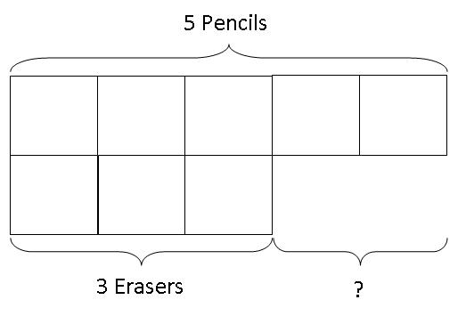
Moving to the abstract
Peter has 5 pencils and 3 erasers. How many more pencils than erasers does he have?
Notes:
Suggest that children are encouraged to visualise the objects in the spaces

Slide 12
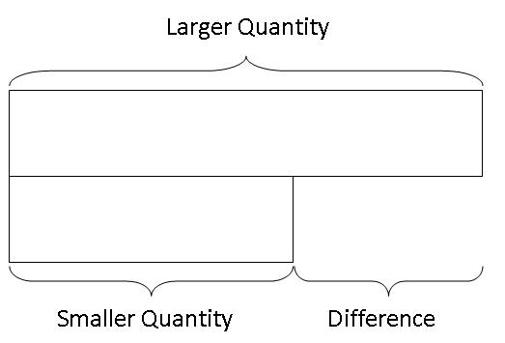
Generalisation
“The shift from model of to model for concurs with a shift in the students thinking, from thinking about the modelled context situation, to a focus on mathematical relations. This is a major landmark in mathematical development”.
(Twomey and Fosnot citing Gravemeijer 2000).
Notes:
Generalising the structure of the mathematics to any context

Slide 13
The relationship between addition and subtraction
a
b
c
a = b + c
a = c + b
a – b = c
a – c = b
Part / whole relationships

Slide 14
Problems to solve
Tom has a bag of 64 marbles. His friend gives him 28 more.
How many does he have now?
Kelsey was running a 26 mile marathon. After 18 miles she felt very tired. How many more miles did she have to run?
Carly bought an apple for 17p and a banana for 26p.
How much has she spent?
Ali had £10. He bought a DVD for £6.70 and a CD for £2.90.
How much money did he have left?
Notes:
Ask participants to use the bar(s) to solve the problems, allow them to record in their own way and then compare how they drew the bars
For problem 2 you might discuss whether 1 or 2 bars were drawn to illustrate the concept of difference

Slide 15
Developing a sense of scale

Slide 16
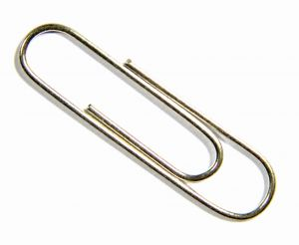
Take a strip and a paperclip
Notes:
Explain that the strip of card is the bar

Slide 17
Your strip represents 10p
Show me 5p
Show me 2p
Show me 8p
Show me 7p
Notes:
Note the following few slides are animated so that each question appears one at a time
To represent cardinal numbers (the last number in the count represents the total size of the group) slide the paper clip from zero (the left hand end of the strip) to the middle, to represent a space representing 5p as a proportion of 10p
Going from 2p to 8p some might turn their strip over, showing the relationship between 2 8 and 10

Slide 18
Your strip represents £1
Show me 50p
Show me 20p
Show me 80p
Show me 70p
Notes:
Link to previous slide

Slide 19
Your strip represents 1 metre
Show me 50cm
Show me half a metre
Show me 20cm
Show me 80cm
Show me 70cm
Notes:
Link to previous slide

Slide 20
Your strip represents £5
Show me £3
Show me £4
Show me £3.50
Show me £3.59
What would the half way mark represent?
Notes:
Link to previous slide

Slide 21
Multiplication, Ratio and Scaling

Slide 22
Multiplication
Peter has 4 books
Harry has five times as many books as Peter.
How many books has Harry?
How might you represent the problem?
4
4
4
4
4
4
Notes:
Discuss the representation, including how it represents multiple addition and scaling for multiplication
The squares on the second line might be pushed together to form one bar
You might also discuss that multiplication always starts at zero (i.e. we don’t start with the original 4 and add 5 more to it, although altogether there are 6 times 4 since Peter has one times, and Harry has 5 times

Slide 23
Multiplication Problems
Henry ate 10 meatballs at the Christmas party. Shane ate 3
times as many meatballs as Henry. How many
meatballs did they eat altogether?
Helen has 9 times as many football cards as Sam. Together
they have 150 cards. How many more cards does Helen have
than Sam?
The sum of 2 numbers is 60. One number is 9 times as big as
the other. What is the bigger number?
The sum of 2 numbers is 64. One number is 7 times as big
as the other. What is the smaller number?
Notes:
Participants draw bars/blocks and calculate the answers to the problems

Slide 24
Sam had 5 times as many marbles as
Tom.
If Sam gives 26 marbles to Tom, the
two friends will have exactly the same
amount.
How many marbles do they have
altogether?
Notes:
This is a complex problem, made easier with the bar. Judge whether or not you wish to use it at this stage

Slide 25
Tim and Sally share marbles in the ratio of
2:3
If Sally has 36 marbles, how many are
there altogether?

Slide 26
Ratio
Tim and Sally share marbles in the ratio of 2:3
If Sally has 36 marbles, how many are there altogether?
Notes:
Additional slides, explore ratio if time

Slide 27
A herbal skin remedy uses honey and yoghurt in the ratio
3 : 4. How much honey is needed to mix with 120 g of
yoghurt?
A health bar sells desserts with chopped apricot and yoghurt
In the ratio 2 : 5.How much chopped apricot will be mixed
with 150 g of yoghurt?

Slide 28
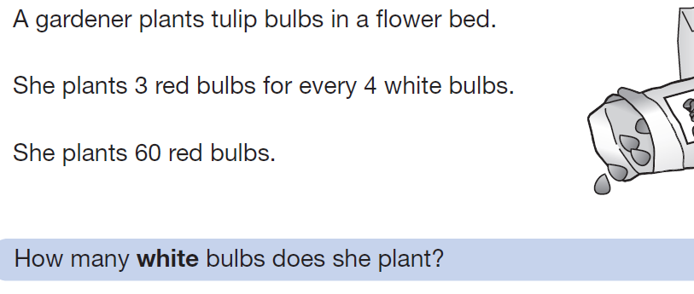
Key Stage 2 SATS

Slide 29
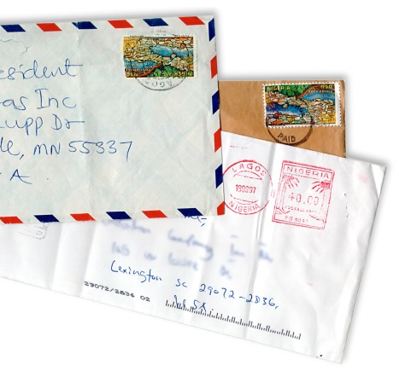
GCSE higher paper 2012!
Ralph posts 40 letters, some of which are first class, and some are second.
He posts four times as many second class letters as first.
How many of each class of letter does he post?

Slide 30
Ratio, Multiplication or Scaling?
The farmer has 24 animals There are three times
as many sheep as cows.
How many Sheep?
How many cows?
The farmer has 42 animals There are twice as many
ducks as cows and three times as many sheep as
cows.
How many Sheep?
How many cows?
How many ducks

Slide 31
Farmer Brown has a third of the sheep that Farmer Giles has.
After 12 of farmer Giles sheep escape into Farmer Browns field they have the same amount.
How many sheep do they have in total?

Slide 32
Developing Fluency Routine: Another and Another
Tom and Sam share stickers.
Keep the ratio 2:3, but change the number of stickers, produce multiple examples:
What numbers are easier?
Can you do the same for the ratio 3:5?

Slide 33
Division and Fractions

Slide 34
Division
Mr Smith had a piece of wood that measured 36 cm.
He cut it into 6 equal pieces. How long was each piece?

Slide 35
Division
24 cakes were shared between 6 children, how many did each receive?
Sam likes to read fantasy stories. His new book is 48 pages long. Sam wants to finish the book in 4 days. How many pages should Sam read each day in order to reach his goal?

Slide 36
Fractions
Principle: Try to keep all sections the same size.
A fraction can only be identified when the whole is divided into equal parts.
Problems might involve reasoning about unknowns, from known information.
Known | Unknown
The whole | A proportion(part)
A proportion (part) | The whole
A proportion (part) | Another proportion (part)

Slide 37
Find a fraction of a number: The whole is known the part is unknown
Find 2/5 of 30
This activity could be a routine to develop fluency. It provides opportunities to practice multiplication and division and connect these operations to fractions

Slide 38
Developing Fluency
Find 2/3 | 24 | Find | Other Routines?
18 | 1/3 | 2/3 of 36
33 | 2/3 | 7/9 of 81
42 | 3/3 | 3/4 of 110
54 | 3/8 | 8/8 of 71
93 | 7/8 | 3/5 of 100

Slide 39
Developing Fluency
Find 2/3 of:
18
33
42
54
93

Slide 40
Developing Fluency
Find:
1/3
2/3
3/3
3/8
24
Using the squared paper, draw the strip you think you need to draw

Slide 41
Developing Fluency
2/3 of 36
7/9 of 81
3/4 of 90
8/8 of 71
3/5 of 100
Consider how the drawing of the divided rectangle might support pupils in seeing the structure of the mathematics and knowing the operations to perform.

Slide 42
Part / whole and part / part relationships
Sam has 24 cupcakes to sell. He sold half on Monday and half of the remainder on Tuesday. How many does he have left to sell?
I cycled from home to Lea Valley Park, a distance of 24 miles. By 10am I had cycled half way and at 11am I had travelled two thirds of the remaining distance. How far had I left to travel?

Slide 43
Reflection on Problem solving
Consider the need to:
Recognise relationships
Keep parts the same size
See and model the structure
Make connections
Reason from what I know

