Slide 1
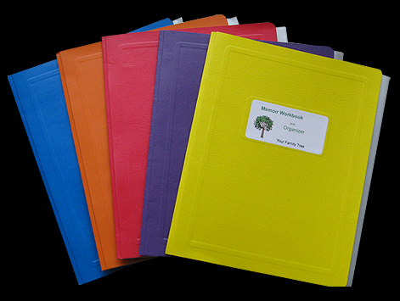
My computing and learning rules.

Slide 2
1:I will always try to collaborate with my partner.
2:I will always try to obey the computing rules.
3:I will try to follow the brain, buddy, boss method.
By Alex

